Slide 1
A System for General In-Hand Object Re-Orientation
CoRL 2021 best paper

Slide 2
Authors
Improbable AI Lab
Tao Chen
Ph.D. student at MIT
intersection of robot learning, manipulation, and navigation.
Jie Xu
Ph.D. student at MIT
intersection of Robotics, Simulation, and Machine Learning
Pulkit Agrawal
Assistant Professor at MIT
build machines that can automatically and continuously learn about their environment
Notes:
All from MIT

Slide 3
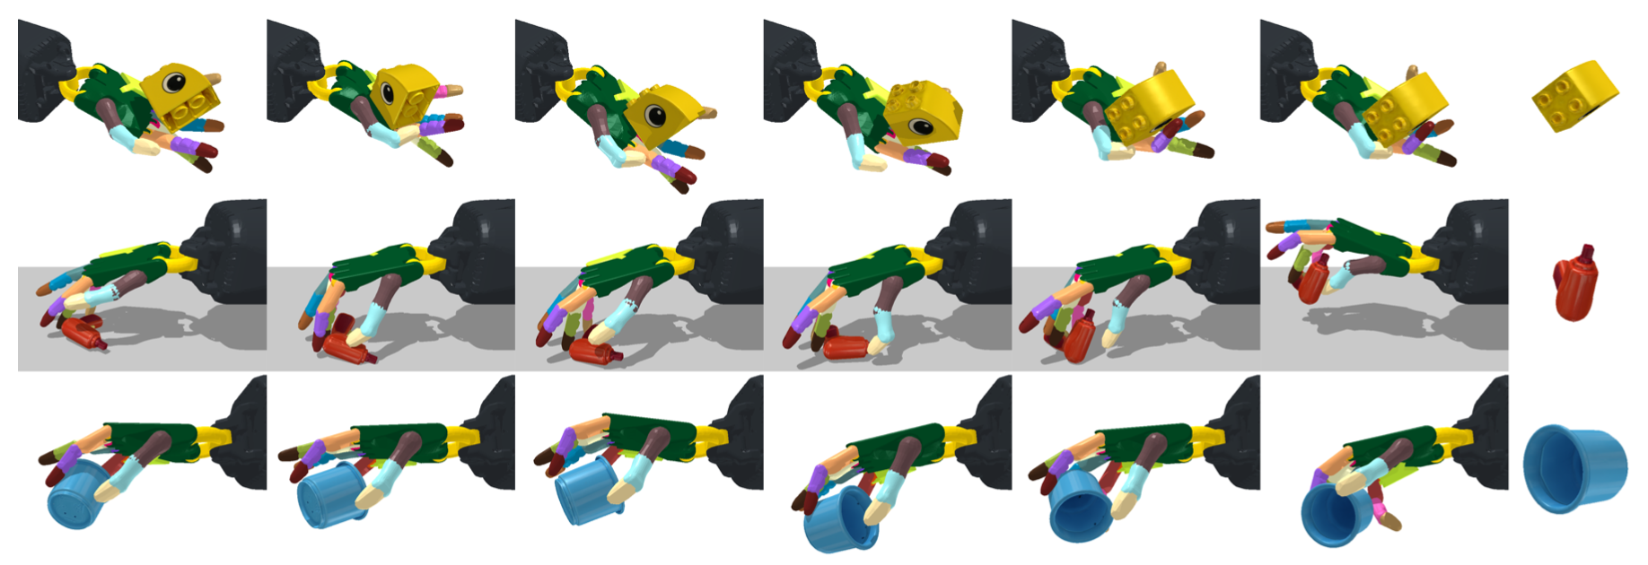
Overview
Overview
A model-free framework that learns to reorient objects of all kinds

Slide 4
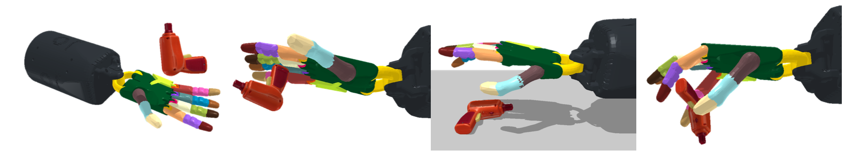
Contributions
Overview
Hand facing upward and downward
Zero-shot transfer on new objects
Try vision-based observation

Slide 5
Method
Method
Teacher-student Learning
Gravity Curriculum
Stable initialization
Notes:
Use distill to obtain a model that can be applied to real world
Improve downward in-hand reorientation performance
Provide initial state for in-air reorientation

Slide 6
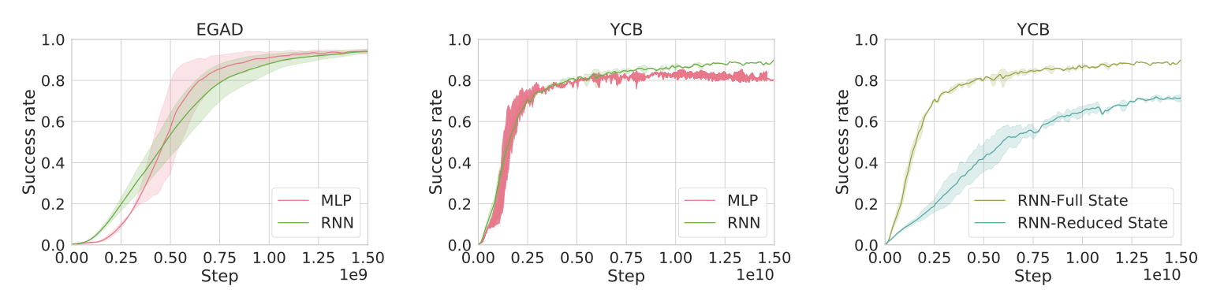
Teacher Policy
Method
Full Observation
MLP or RNN
Dynamic randomization
Notes:
Full state observation
Joint angle change for action

Slide 7
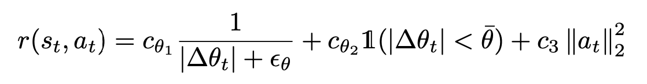
Teacher Policy
Method
Reward Function
Notes:
Full state observation
Joint angle change for action

Slide 8
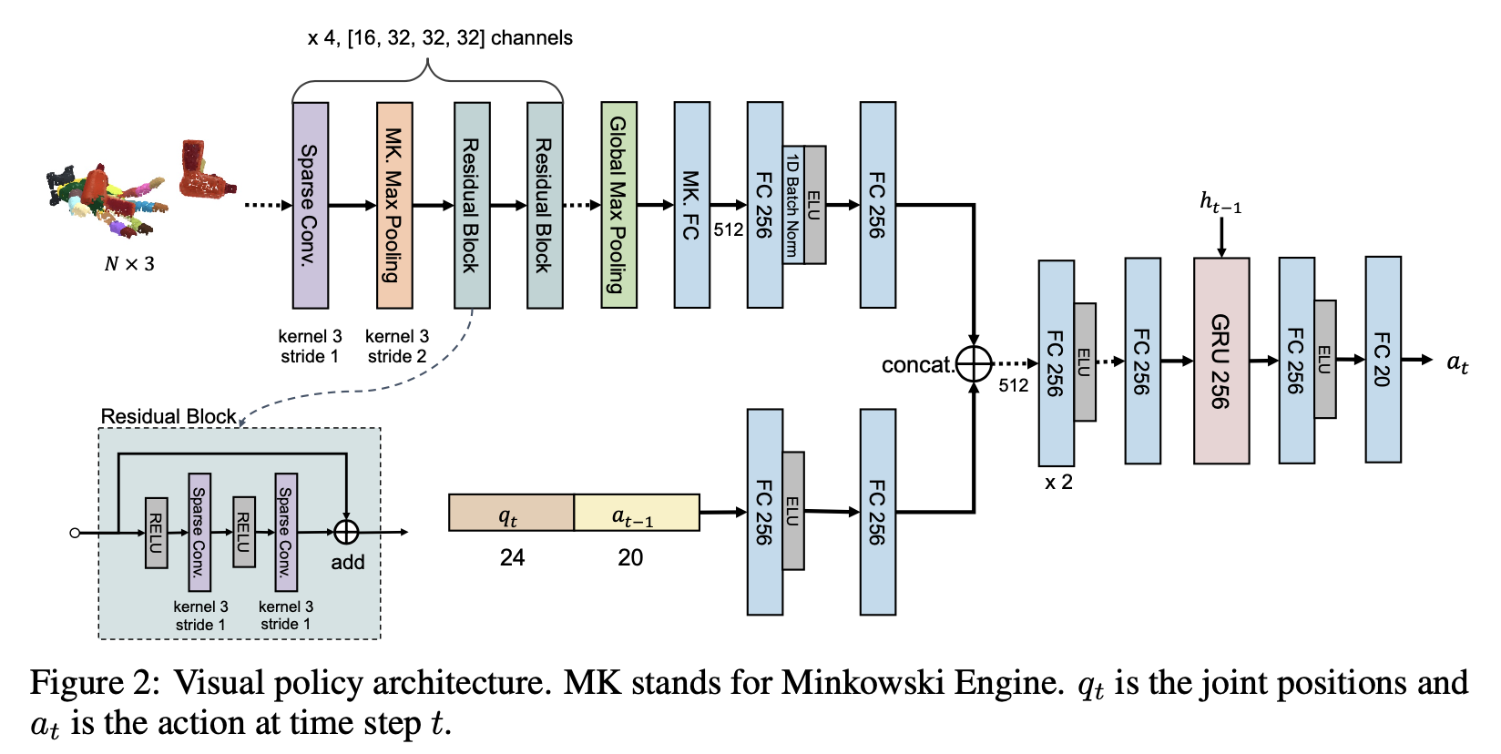
Student Policy
Method
Reduced Observation
Which can be obtained when in real world
Vision or Non-vision
Notes:
Reduced state or RGBD image
Sparse3D-IMPALA-Net
New criterion
Symmetry issue

Slide 9
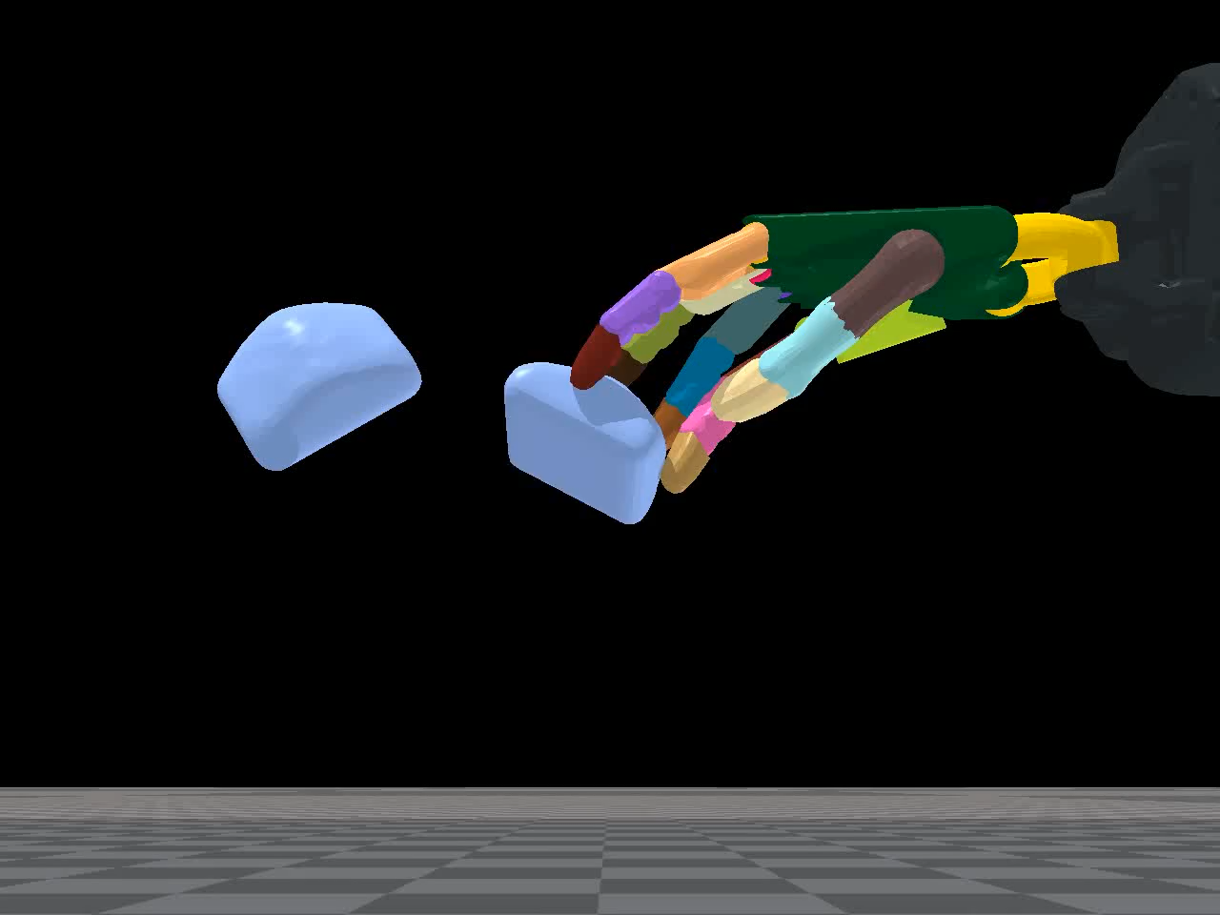
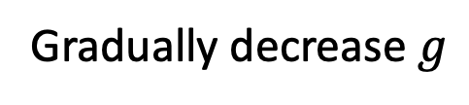
Gravity Curriculum
Method
Hand facing downward and in air
Gradually decrease $g$
Notes:
Gravity makes it more difficult
Start with $1m/s^{2}$, decrease $0.5m/s^{2}$ per-time if success rate is over 0.8, until $g=−9.81m/s^{2}$

Slide 10
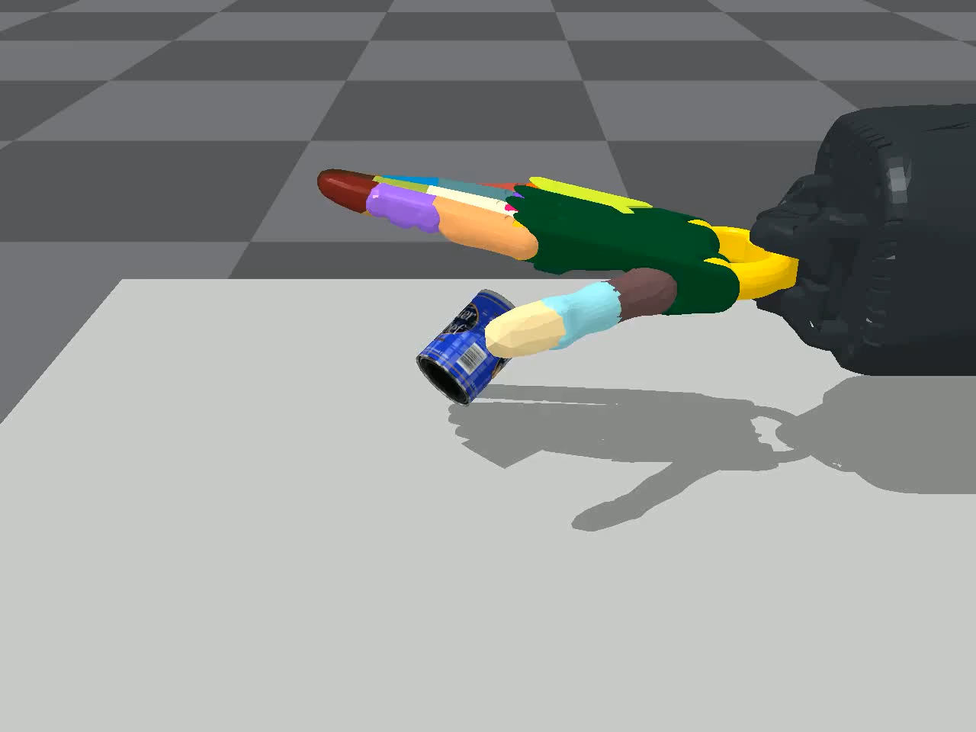
Stable Initialization
Method
Reorient in air
A separate RNN to lift objects
Notes:
Initial state is essential
Which achieves high success rate on grasping

Slide 11
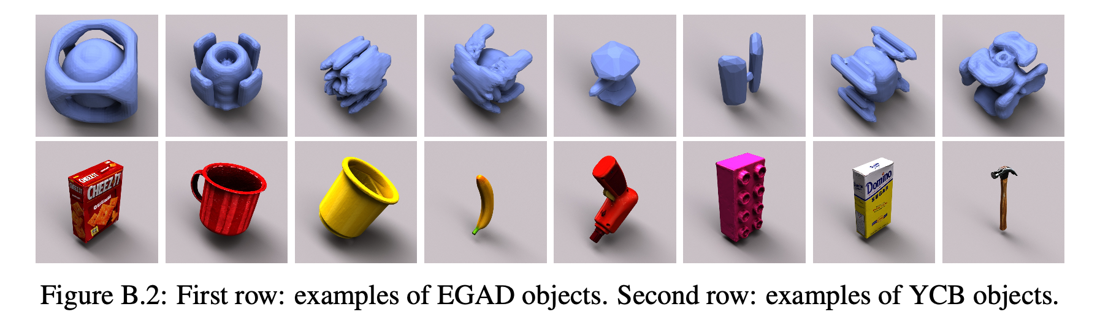
Experiments
Experiments
Dataset
Facing upward and downward (with and without table)
Vision-based student policy
Notes:
2282 in EGAD without texture
78 in YCB with texture(more difficult)

Slide 12
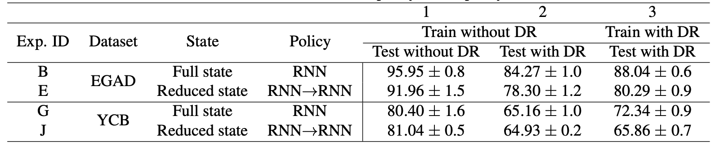
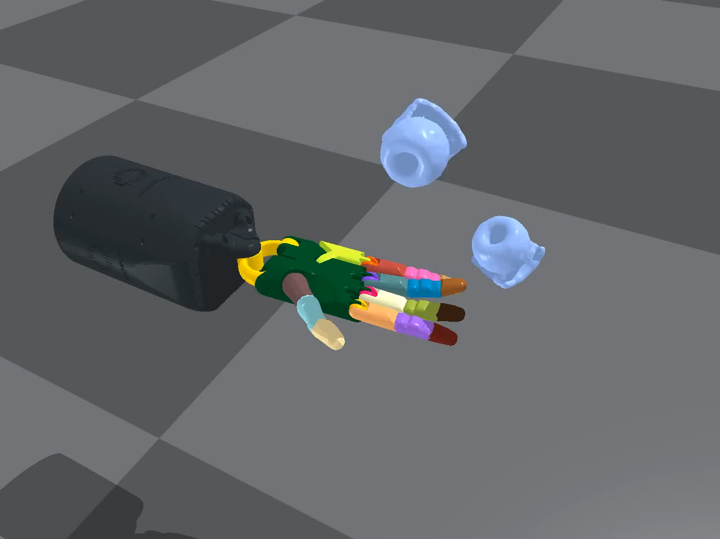
Facing upward
Experiments
Results
Throw and Catch
Failure
Notes:
Throw into air with a spin and catch at precise time
Fail on small, thin, long objects due to shape agnostic

Slide 13
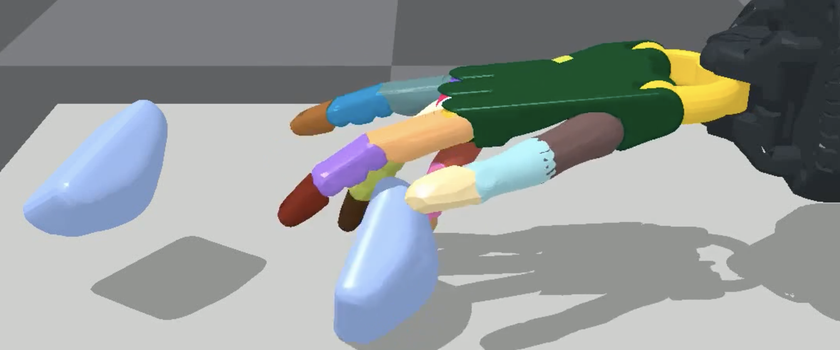
Facing downward with table
Experiments
Results
MLP policy for EGAD and YCB is 95.31% ± 0.9% and 81.59% ± 0.7%
External Force

Slide 14
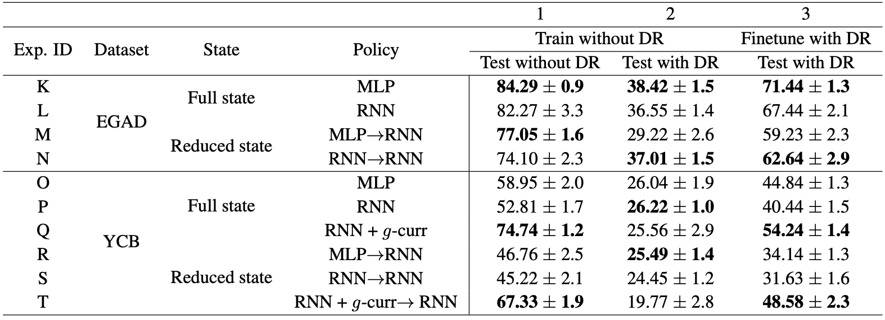
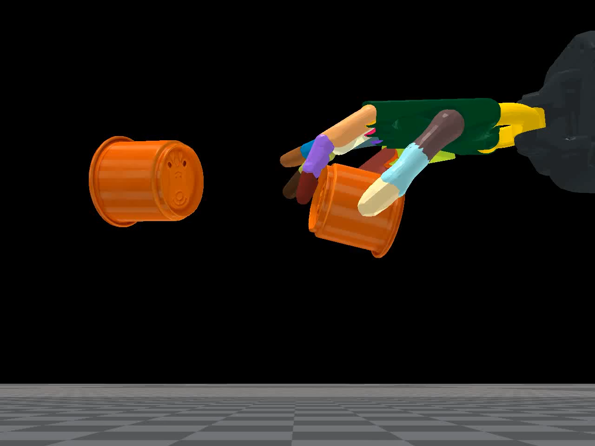
Facing downward without table
Experiments
Results
Also Throw and Catch

Slide 15
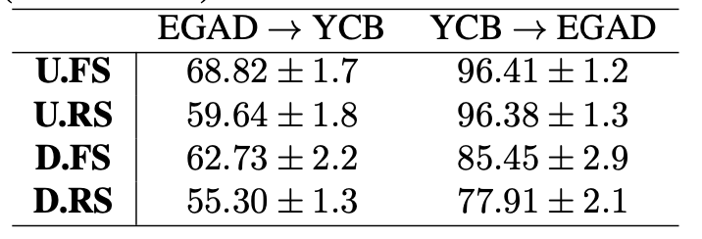
Zero-shot Transfer
Experiments
Results
Shape-agnostic

Slide 16
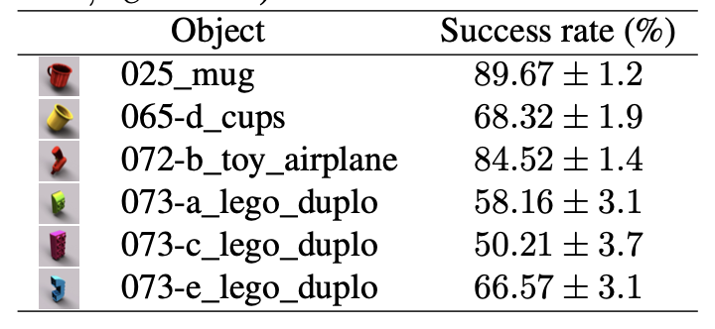
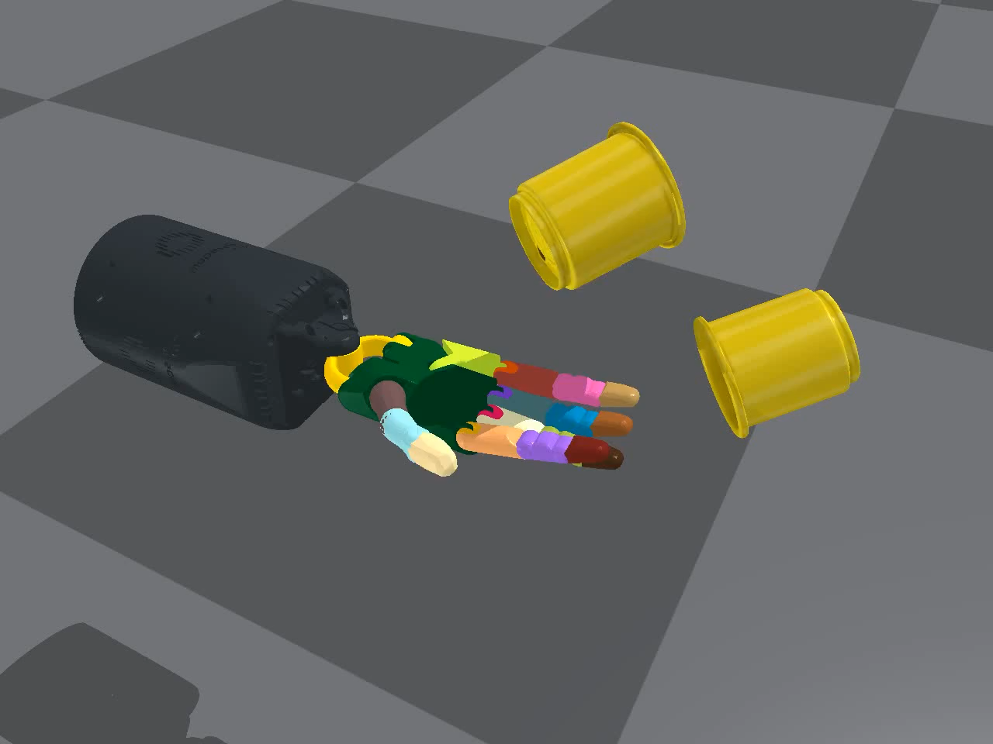
Vision-based
Experiments
Constraints
Results
Notes:
One model for each object
MLP for upward to supervise

Slide 17
Comment
Comment
Highly Dynamic
Reduced State can be obtained?
Shape-agnostic?
Notes:
赤道附近g=9.780米/秒^2,北极地区g=9.832米/秒^2

